Slide 1
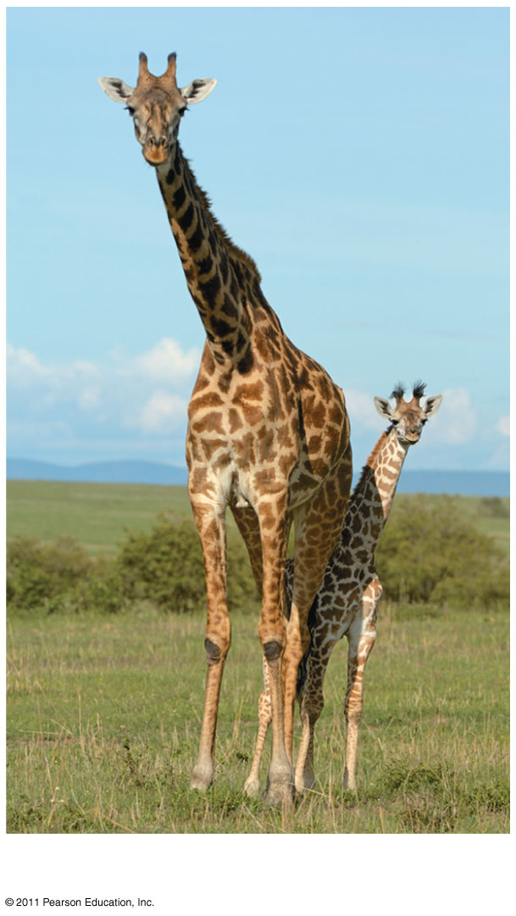
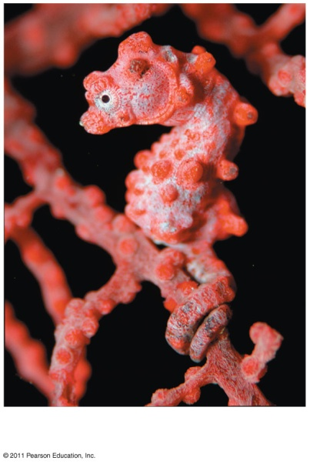
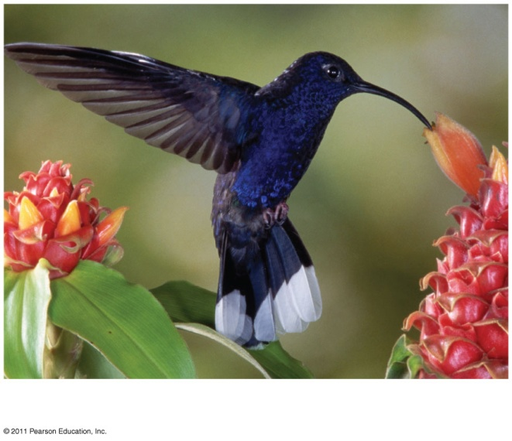
Chapter 1
Study of Life

Slide 2
Inquiring About Life
Biology is the scientific study of life
Biologists ask questions such as:
How does a single cell develop into an organism?
How does the human mind work?
How do living things interact in communities?
Life is recognized by what living things do

Slide 3
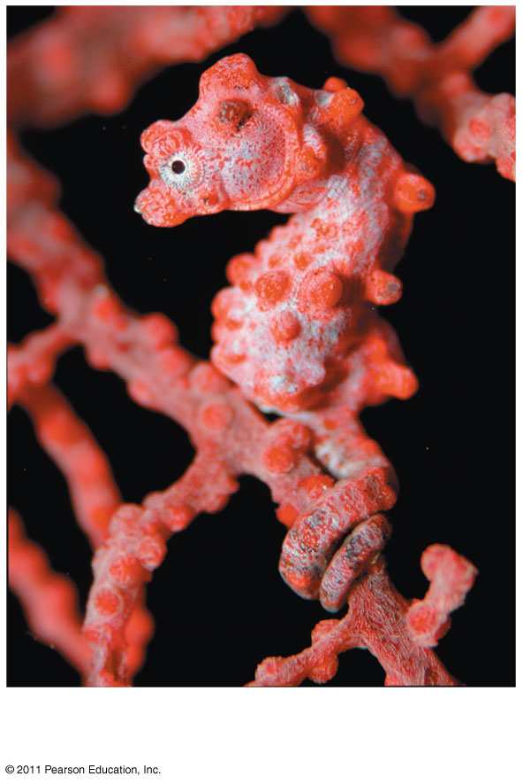
Properties of Life
Evolutionary Adaptation

Slide 4
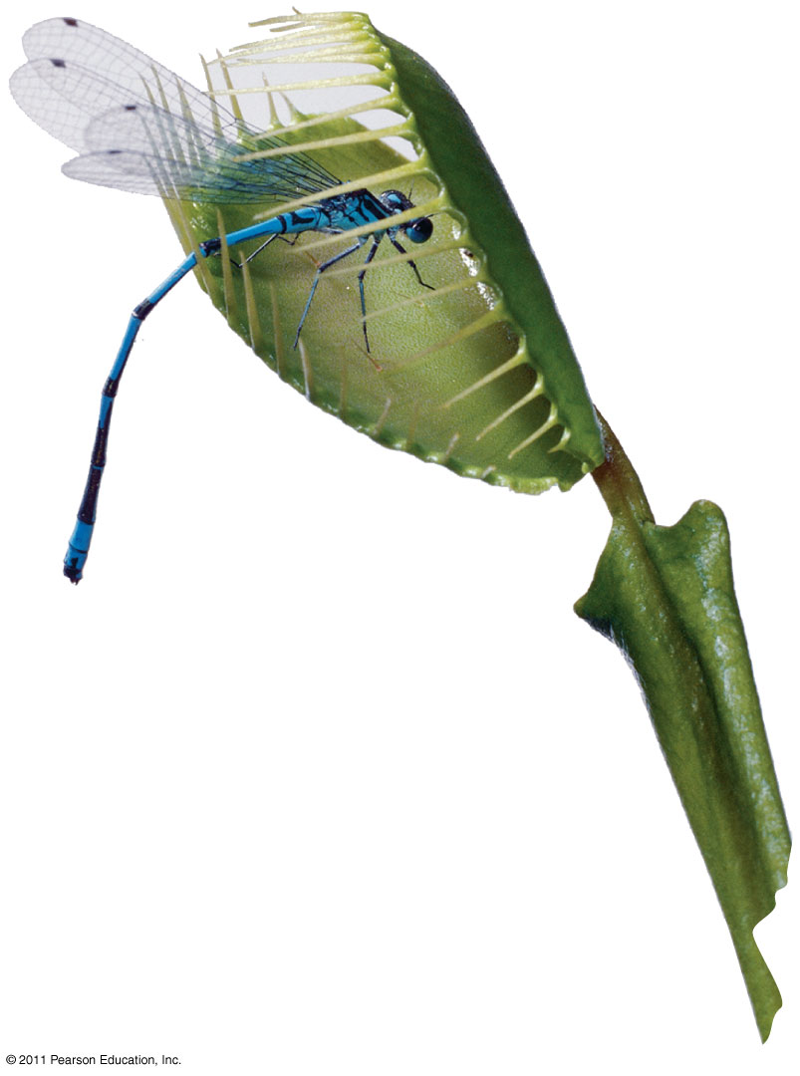
Properties of Life
Response to environment

Slide 5
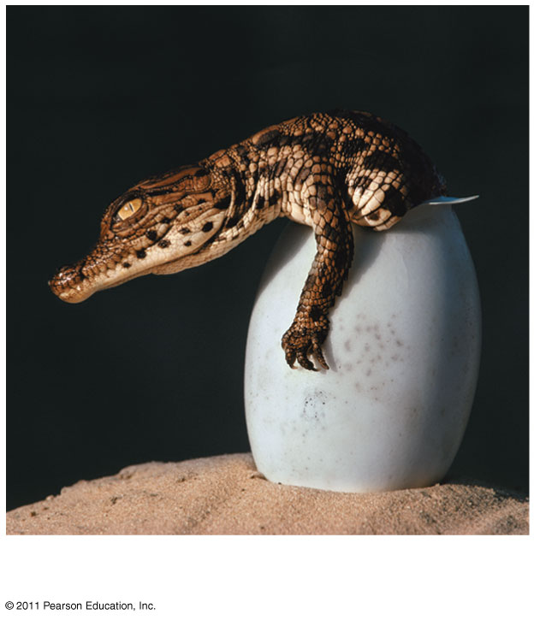
Properties of Life
Growth and Development

Slide 6
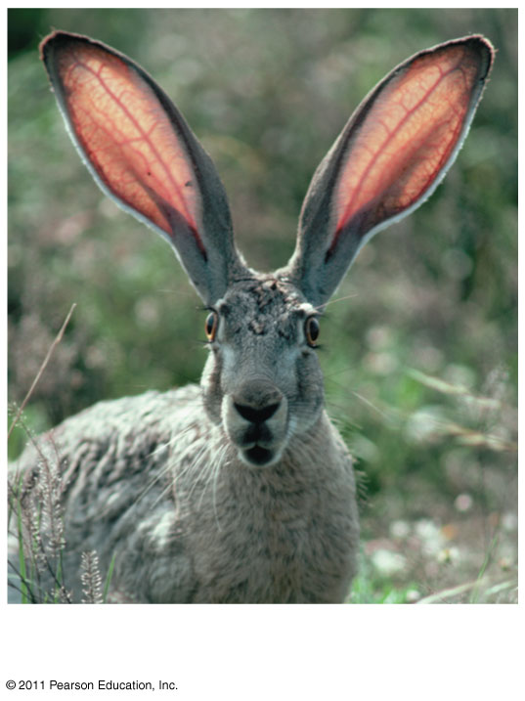
Properties of Life
Reproduction Regulation

Slide 7
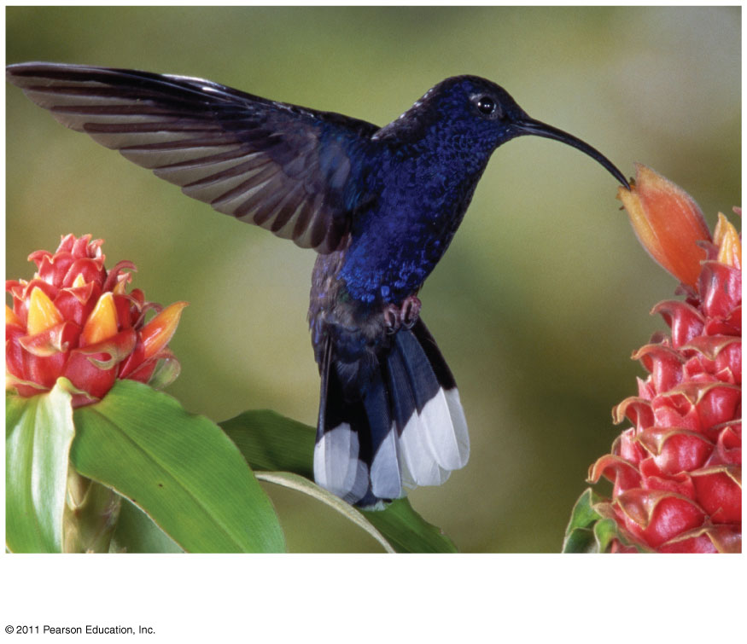
Properties of Life
Energy Processing Order

Slide 8
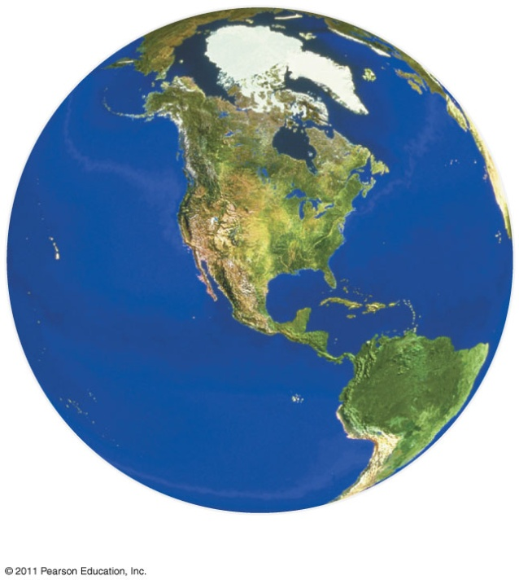
Themes in Biology
The study of life can be divided into different levels of biological organization
Biosphere Ecosystems

Slide 9
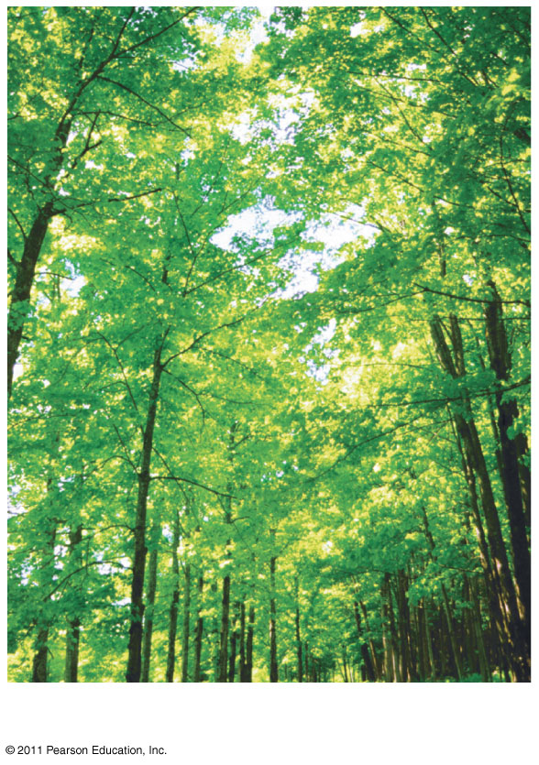
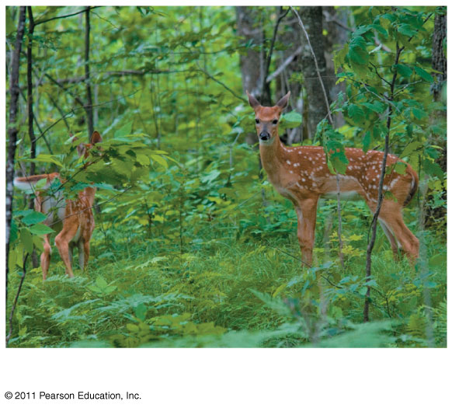
Themes in Biology
Communities Populations

Slide 10
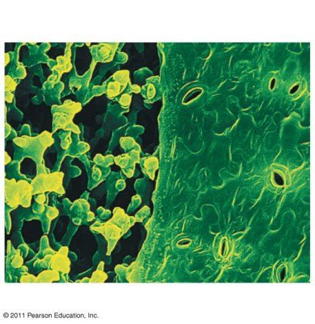
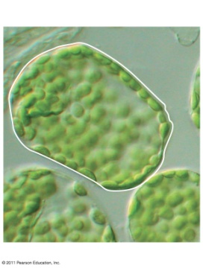
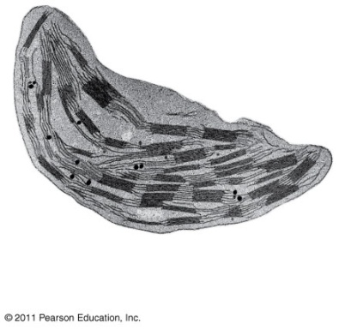
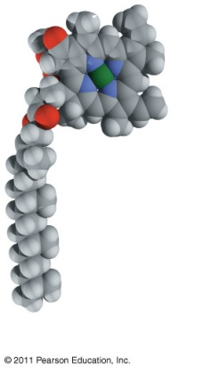
Themes in Biology
Organisms Organs Tissues
Cells Organelles Molecules

Slide 11
Themes in Biology
Every organism interacts with its environment, including nonliving factors and other organisms
Both organisms and their environments are affected by the interactions between them
For example, a tree takes up water and minerals from the soil and carbon dioxide from the air; the tree releases oxygen to the air and roots help form soil

Slide 12
Interaction of an African tree with the organisms/environment
Notes:
Sunlight is absorbed by tree, leaves take in carbon dioxide, release oxygen, elephant eats the leaves, leaves fall, they are decomposed by organisms that recycle nutrients back to soil, taken up by the roots of trees

Slide 13
Themes in Biology
Humans have modified our environment
For example, half the human-generated CO₂ stays in the atmosphere and contributes to global warming
Global warming is a major aspect of global climate change

Slide 14
Themes in Biology
A fundamental characteristic of living organisms is their use of energy to carry out life’s activities
Work, including moving, growing, and reproducing, requires a source of energy
Living organisms transform energy from one form to another
For example, light energy is converted to chemical energy, then kinetic energy
Energy flows through an ecosystem, usually entering as light and exiting as heat

Slide 15
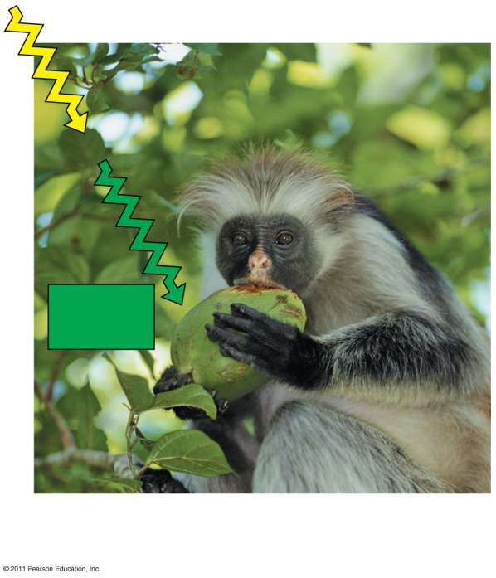
Energy flow in an ecosystem
Producers absorb light energy and transform it into chemical energy
Chemical energy in food is transferred from plants to consumers

Slide 16
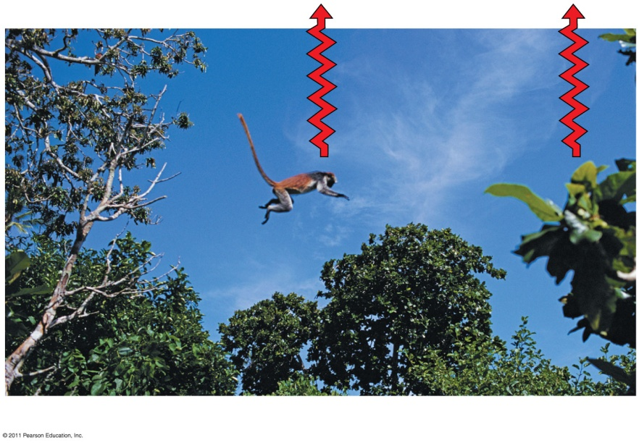
Energy Flow
An animals muscle cells convert chemical energy from food to kinetic energy (energy of motion)
When energy is used to do work, some is converted to thermal energy, which is lot as heat
Notes:
Plant cells use Chemical Energy to do work by growing new leaves

Slide 17
Structure and Function Are Correlated
Structure and function of living organisms are closely related
For example, a leaf is thin and flat, maximizing the capture of light by chloroplasts
For example, the structure of a bird’s wing is adapted to flight

Slide 18
Themes in Biology
The cell is the lowest level of organization that can perform all activities required for life
All cells
Are enclosed by a membrane
Use DNA as their genetic information

Slide 19
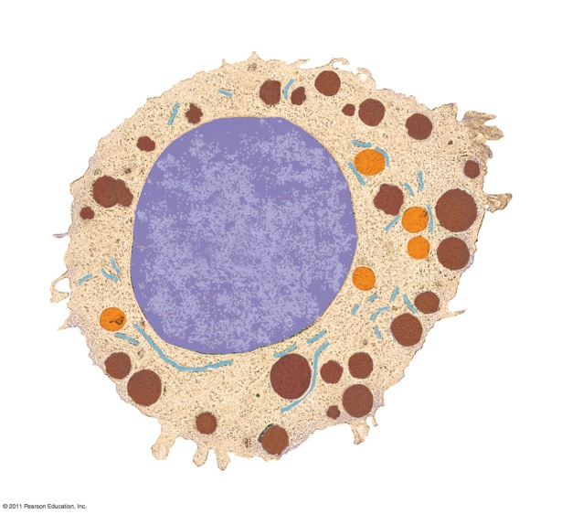
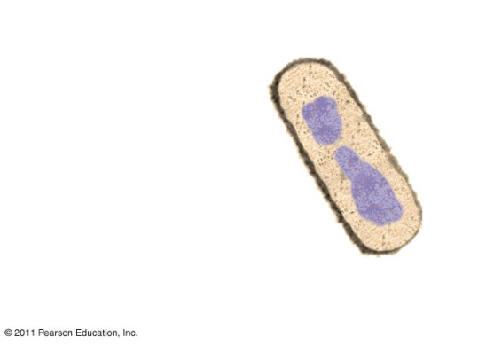
Themes in Biology
A eukaryotic cell has membrane-enclosed organelles, the largest of which is usually the nucleus
By comparison, a prokaryotic cell is simpler and usually smaller, and does not contain a nucleus or other membrane-enclosed organelles

Slide 20
The Continuity of life is based on heritable information from DNA
Chromosomes contain most of a cell’s genetic material in the form of DNA (deoxyribonucleic acid)
Genes are the units of inheritance that transmit information from parents to offspring
The ability of cells to divide is the basis of all reproduction, growth, and repair of multicellular organisms

Slide 21
A lung cell from a newt divides into two smaller cells that will grow and divide again.

Slide 22
DNA Structure and Function
Each chromosome has one long DNA molecule with hundreds or thousands of genes
Genes encode information for building proteins
DNA is inherited by offspring from their parents
DNA controls the development and maintenance of organisms

Slide 23
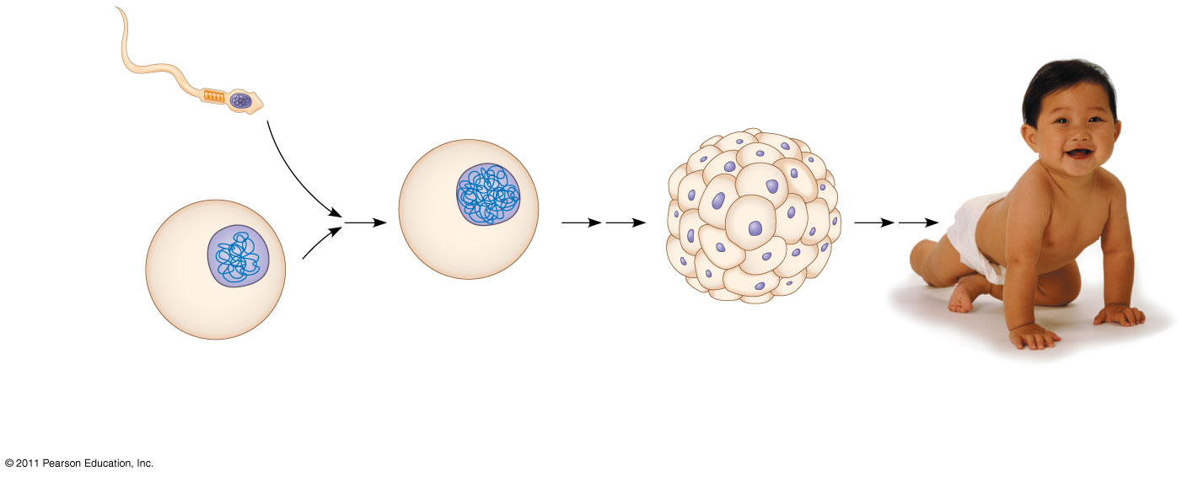
Inherited DNA directs development of an organism.
sperm cell
Nuclei containing
DNA
Egg cell
fertilized egg containing DNA from embryo’s cells with Offspring with inherited
both parents copies of inherited DNA traits from both parents

Slide 24
DNA Structure and Function
Genes control protein production indirectly
DNA is transcribed into RNA then translated into a protein
Gene expression is the process of converting information from gene to cellular product
Genomics is the study of sets of genes within and between species

Slide 25
Feedback Mechanisms Regulate Biological Systems
Feedback mechanisms allow biological processes to self-regulate
Negative feedback means that as more of a product accumulates, the process that creates it slows and less of the product is produced
Positive feedback means that as more of a product accumulates, the process that creates it speeds up and more of the product is produced

Slide 26
Themes in Biology
Evolution makes sense of everything we know about biology
Organisms are modified descendants of common ancestors
Evolution explains patterns of unity and diversity in living organisms
Similar traits among organisms are explained by descent from common ancestors

Slide 27
Classifying the Diversity of Life
Approximately 1.8 million species have been identified and named to date, and thousands more are identified each year
Estimates of the total number of species that actually exist range from 10 million to over 100 million

Slide 28
Grouping Species: The Basic Idea
Taxonomy is the branch of biology that names and classifies species into groups
Domains, followed by kingdoms, are the broadest units of classification

Slide 29
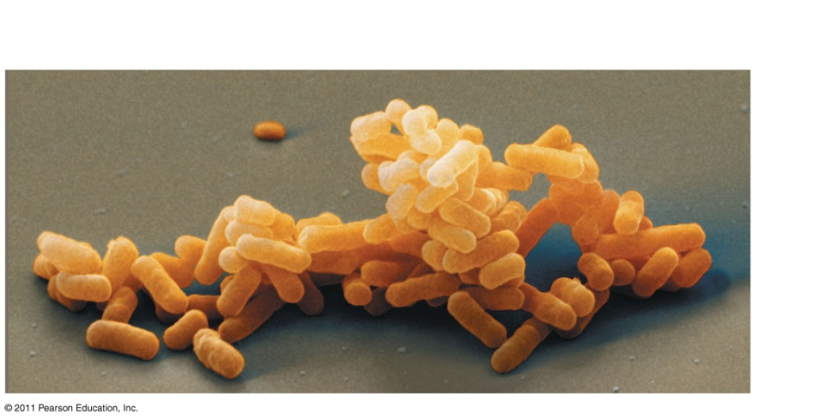
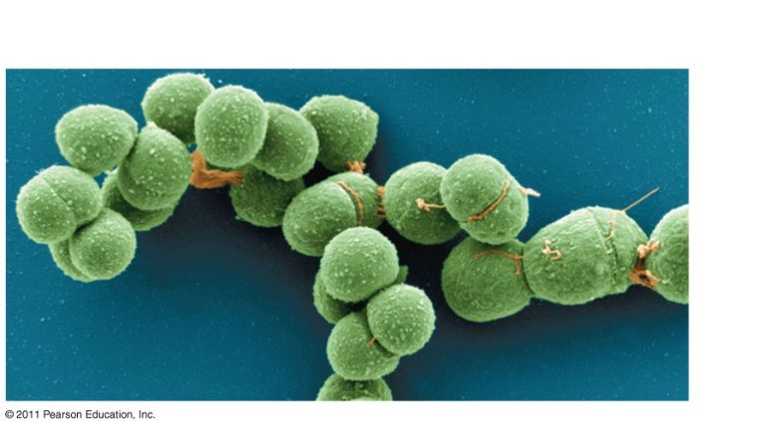
The Three Domains of Life
Organisms are divided into three domains
Domain Bacteria and domain Archaea compose the prokaryotes
Most prokaryotes are single-celled and microscopic
Domain Bacteria Domain Archaea

Slide 30
The Three Domains of Life
Domain Eukarya includes all eukaryotic organisms
Domain Eukarya includes three multicellular kingdoms
Plants, which produce their own food by photosynthesis
Fungi, which absorb nutrients
Animals, which ingest their food
Other eukaryotic organisms are grouped into the Protist kingdom

Slide 31
The Three Domains of Life

Slide 32
Unity in the Diversity of Life
A striking unity underlies the diversity of life; for example
DNA is the universal genetic language common to all organisms
Unity is evident in many features of cell structure

Slide 33
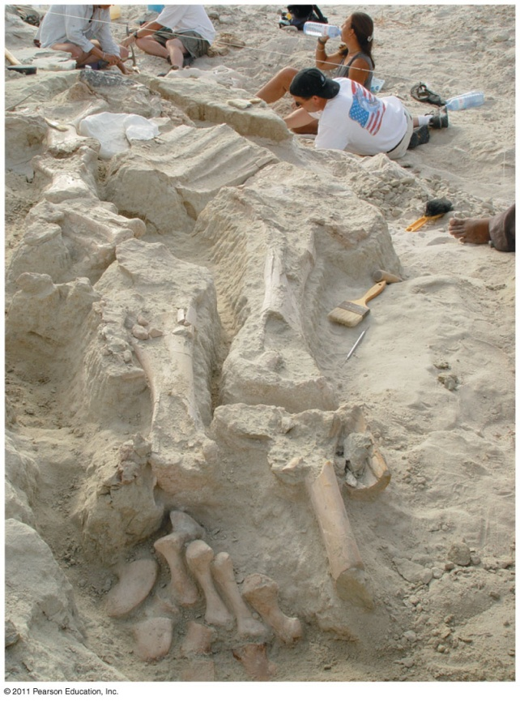
Charles Darwin and the Theory of Natural Selection
Fossils and other evidence document the evolution of life on Earth over billions of years

Slide 34
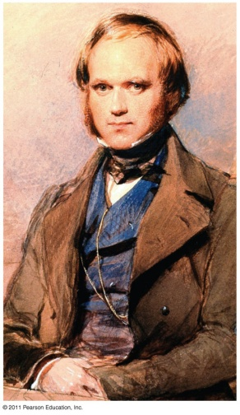
Charles Darwin
Charles Darwin published On the Origin of Species by Means of Natural Selection in 1859
Darwin made two main points:
Species showed evidence of “descent with modification” from common ancestors
Natural selection is the mechanism behind “descent with modification”
Darwin’s theory explained the duality of unity and diversity

Slide 35
Charles Darwin and the Theory of Natural Selection
Darwin observed :
Individuals in a population vary in their traits, many of which are heritable
More offspring are produced than survive, and competition is inevitable
Species generally suit their environment

Slide 36
Charles Darwin and the Theory of Natural Selection
Darwin inferred:
Individuals that are best suited to their environment are more likely to survive and reproduce
Over time, more individuals in a population will have the advantageous traits
environment “selects” for the propagation of beneficial traits
Darwin called this process natural selection

Slide 37
Studying Nature
scientists make observations and then form and test hypotheses
The scientific process includes making observations, forming logical hypotheses, and testing them

Slide 38
Types of Data
Data are recorded observations or items of information; these fall into two categories
Qualitative data, or descriptions rather than measurements
For example, Jane Goodall’s observations of chimpanzee behavior
Quantitative data, or recorded measurements, which are sometimes organized into tables and graphs

Slide 39
Qualitative Data

Slide 40
Inductive Reasoning
Inductive reasoning draws conclusions through the logical process of induction
Repeating specific observations can lead to important generalizations
For example, “the sun always rises in the east”

Slide 41
Forming and Testing Hypotheses
Observations and inductive reasoning can lead us to ask questions and propose hypothetical explanations called hypotheses
A hypothesis is a tentative answer to a well-framed question
A scientific hypothesis leads to predictions that can be tested by observation or experimentation

Slide 42
Forming and Testing Hypotheses
For example,
Observation: Your flashlight doesn’t work
Question: Why doesn’t your flashlight work?
Hypothesis 1: The batteries are dead
Hypothesis 2: The bulb is burnt out
Both these hypotheses are testable

Slide 43
Science benefits from a cooperative approach and diverse viewpoints
In science, observations and experimental results must be repeatable
Most scientists work in teams, which often include graduate and undergraduate students
Good communication is important in order to share results through seminars, publications, and websites

Slide 44
Building on the Work of Others
Scientists check each others’ claims by performing similar experiments
It is not unusual for different scientists to work on the same research question
Scientists cooperate by sharing data about model organisms

Slide 45
Science, Technology, and Society
The goal of science is to understand natural phenomena
The goal of technology is to apply scientific knowledge for some specific purpose
Science and technology are interdependent
Biology is marked by “discoveries,” while technology is marked by “inventions”

Slide 46
Science, Technology, and Society
The combination of science and technology has dramatic effects on society
For example, the discovery of DNA by James Watson and Francis Crick allowed for advances in DNA technology such as testing for hereditary diseases
Science benefits from diverse views from different racial and ethnic groups, and from both women and men

Slide 47
Chapter 2
The Chemical Context of Life

Slide 48
A Chemical Connection to Biology
Biology is a multidisciplinary science
Living organisms are subject to basic laws of physics and chemistry

Slide 49
Matter
consists of chemical elements in pure form and in combinations called compounds
Organisms are composed of matter
Matter is anything that takes up space and has mass

Slide 50
Elements and Compounds
Matter is made up of elements
An element is a substance that cannot be broken down to other substances by chemical reactions
A compound is a substance consisting of two or more elements in a fixed ratio
A compound has characteristics different from those of its elements

Slide 51
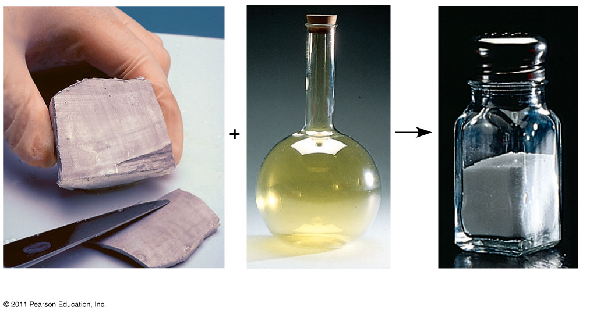
Elements and Compounds
Sodium Chlorine Sodium Chloride

Slide 52
The Elements of Life
About 20–25% of the 92 elements are essential to life
Carbon, hydrogen, oxygen, and nitrogen make up 96% of living matter
Most of the remaining 4% consists of calcium, phosphorus, potassium, and sulfur
Trace elements are those required by an organism in minute quantities

Slide 53
The Elements of Life

Slide 54
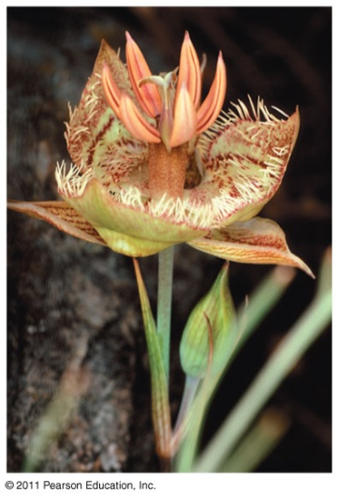
Evolution of Tolerance to Toxic Elements
Some elements can be toxic, for example, arsenic
Some species can become adapted to environments containing toxic elements
For example, some plant communities are adapted to serpentine

Slide 55
An element’s properties depend on the structure of its atoms
Each element consists of unique atoms
An atom is the smallest unit of matter that still retains the properties of an element

Slide 56
Atomic Structure
Atoms are composed of subatomic particles
Relevant subatomic particles include
Neutrons (no electrical charge)
Protons (positive charge)
Electrons (negative charge)

Slide 57
Subatomic Particles
Neutrons and protons form the atomic nucleus
Electrons form a cloud around the nucleus
Neutron mass and proton mass are almost identical and are measured in daltons

Slide 58
Cloud of Negative Charge

Slide 59
Atomic Number and Atomic Mass
Atoms of the various elements differ in number of subatomic particles
An element’s atomic number is the number of protons in its nucleus
An element’s mass number is the sum of protons plus neutrons in the nucleus
Atomic mass, the atom’s total mass, can be approximated by the mass number

Slide 60
Isotopes
All atoms of an element have the same number of protons but may differ in number of neutrons
Isotopes are two atoms of an element that differ in number of neutrons
Radioactive isotopes decay spontaneously, giving off particles and energy

Slide 61
Isotopes
Some applications of radioactive isotopes in biological research are
Dating fossils
Tracing atoms through metabolic processes
Diagnosing medical disorders

Slide 62
The Energy Levels of Electrons
Energy is the capacity to cause change
Potential energy is the energy that matter has because of its location or structure
The electrons of an atom differ in their amounts of potential energy
An electron’s state of potential energy is called its energy level, or electron shell

Slide 63
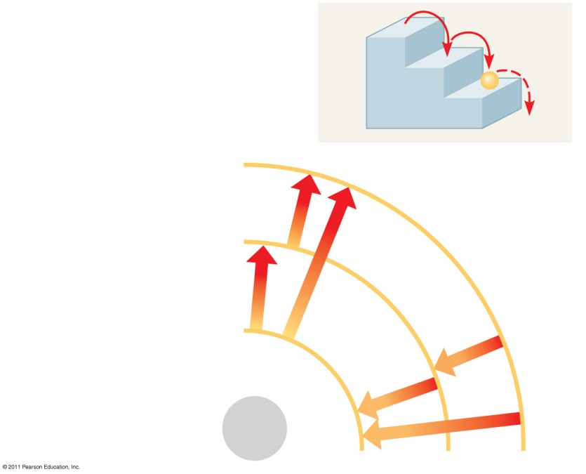
The Energy Levels of Electrons
A ball bouncing down a flight
of stairs provides an analogy
For energy levels of electrons
Third shell (highest energy
level in this model)
Energy
absorbed
Second shell (higher
energy level)
First shell (lowest energy Energy lost
level)

Slide 64
Electron Distribution and Chemical Properties
The chemical behavior of an atom is determined by the distribution of electrons in electron shells
The periodic table of the elements shows the electron distribution for each element

Slide 65
Properties of Electrons
Valence electrons are those in the outermost shell, or valence shell
The chemical behavior of an atom is mostly determined by the valence electrons
Elements with a full valence shell are chemically inert

Slide 66
Formation and Function of molecules
depend on chemical bonding between atoms
Atoms with incomplete valence shells can share or transfer valence electrons with certain other atoms
These interactions usually result in atoms staying close together, held by attractions called chemical bonds

Slide 67
Covalent Bonds
A covalent bond is the sharing of a pair of valence electrons by two atoms
In a covalent bond, the shared electrons count as part of each atom’s valence shell

Slide 68
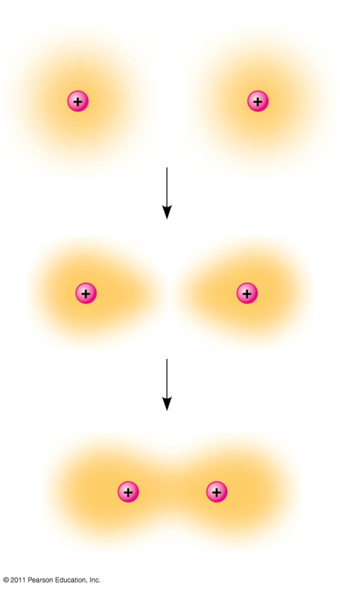
Covalent Bonds
Hydrogen atoms (2 H)
Hydrogen molecule (H₂)

Slide 69
Covalent Bonds
A molecule consists of two or more atoms held together by covalent bonds
A single covalent bond, or single bond, is the sharing of one pair of valence electrons
A double covalent bond, or double bond, is the sharing of two pairs of valence electrons

Slide 70
Covalent Bonds

Slide 71
Covalent Bonds
The notation used to represent atoms and bonding is called a structural formula
For example, H—H
This can be abbreviated further with a molecular formula
For example, H₂

Slide 72
Covalent Bonds
Covalent bonds can form between atoms of the same element or atoms of different elements
A compound is a combination of two or more different elements
Bonding capacity is called the atom’s valence

Slide 73
Covalent Bonds
Atoms in a molecule attract electrons to varying degrees
Electronegativity is an atom’s attraction for the electrons in a covalent bond
The more electronegative an atom, the more strongly it pulls shared electrons toward itself

Slide 74
Covalent Bonds
In a nonpolar covalent bond, the atoms share the electron equally
In a polar covalent bond, one atom is more electronegative, and the atoms do not share the electron equally
Unequal sharing of electrons causes a partial positive or negative charge for each atom or molecule

Slide 75
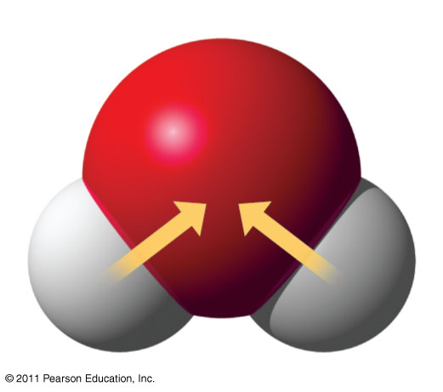
Covalent Bonds
water molecule

Slide 76
Covalent Bonds

Slide 77
Ionic Bonds
Atoms sometimes strip electrons from their bonding partners
An example is the transfer of an electron from sodium to chlorine
After the transfer of an electron, both atoms have charges
A charged atom (or molecule) is called an ion

Slide 78
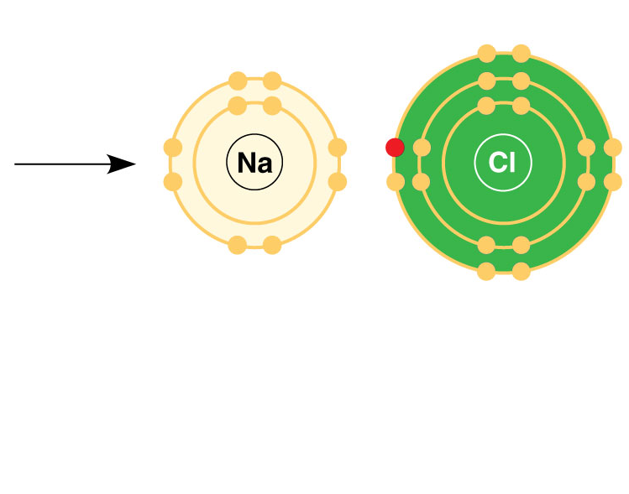
Ionic Bonds

Slide 79
Ionic Bonds
A cation is a positively charged ion
An anion is a negatively charged ion
An ionic bond is an attraction between an anion and a cation

Slide 80
Ionic Bonds
Compounds formed by ionic bonds are called ionic compounds, or salts
Salts, such as sodium chloride (table salt), are often found in nature as crystals

Slide 81
Chemical Bonds
Most of the strongest bonds in organisms are covalent bonds that form a cell’s molecules
Weak chemical bonds, such as ionic bonds and hydrogen bonds, are also important
Weak chemical bonds reinforce shapes of large molecules and help molecules adhere to each other

Slide 82
Hydrogen Bonds
A hydrogen bond forms when a hydrogen atom covalently bonded to one electronegative atom is also attracted to another electronegative atom
In living cells, the electronegative partners are usually oxygen or nitrogen atoms

Slide 83
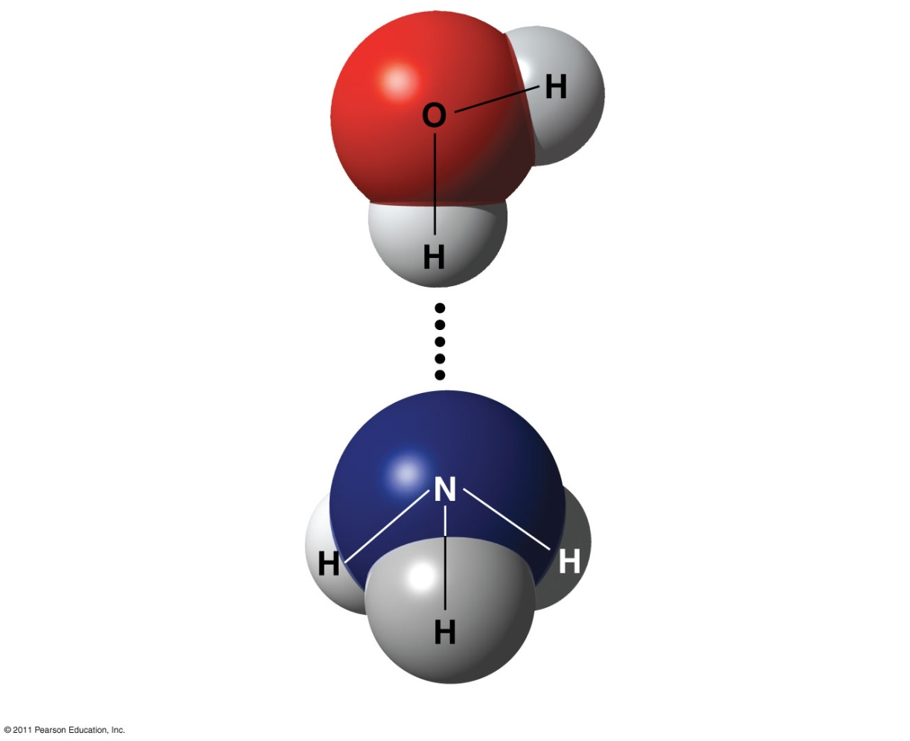
Hydrogen Bonds
Water
Hydrogen
Bond
Ammonia

Slide 84
Molecular Shape and Function
Biological molecules recognize and interact with each other with a specificity based on molecular shape
Molecules with similar shapes can have similar biological effects

Slide 85
Chemical Reactions
Chemical reactions are the making and breaking of chemical bonds
The starting molecules of a chemical reaction are called reactants
The final molecules of a chemical reaction are called products

Slide 86
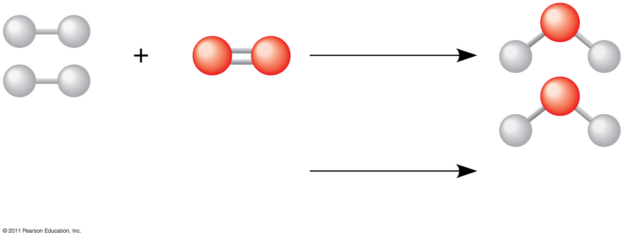
Chemical Reactions
Reactants Products
Notes:
Two hydrogen molecules plus an oxygen molecule give you two water molecules

Slide 87
Chemical Reactions
Photosynthesis is an important chemical reaction
Sunlight powers the conversion of carbon dioxide and water to glucose and oxygen
6 CO₂ + 6 H₂0 → C₆H₁₂O₆ + 6 O₂

Slide 88
Chemical Reactions
All chemical reactions are reversible: products of the forward reaction become reactants for the reverse reaction
Chemical equilibrium is reached when the forward and reverse reaction rates are equal

